Slide 1

Institute Technology of Cambodia
Subject : Data Mining
Topic :
Suicide Rate detect and remove outlier
Lecturers: PHAUK Sokkhey and CHAN Sophal
Student’s name: SOEUM Zera
Class : M1 Computer Science

Slide 2
Contents
Introduction
Outlier technique
Code for outlier detection and removal
Question

Slide 3
1. Introduction
1. Introduction
Project Topic:
More than 700 000 people die due to suicide every year.
For every suicide there are many more people who attempt suicide. A prior suicide attempt is the single most important risk factor for suicide in the general population.
77% of global suicides occur in low- and middle-income countries

Slide 4
1. Introduction (Cont.)
Project Question
Who is at risk?
Many suicides happen impulsively in moments of crisis with a breakdown in the ability to deal with life stresses, such as financial problems, relationship break-up or chronic pain and illness.

Slide 5
1. Introduction (Cont.)
Project Background
Suicide worldwide in 2019: Global Health Estimates
LIVE LIFE: An implementation guide for suicide prevention in countries
Preventing suicide: A global imperative
Mental Health Gap Action Programme Intervention Guide (mhGAP-IG)
Mental Health Action Plan 2013-2020
Preventing suicide: a resource series

Slide 6
2. Outlier technique
Z-score treatment
In this article, we discussed about Z-score treatment which we can detect the presence of outliers and remove them.

Slide 7
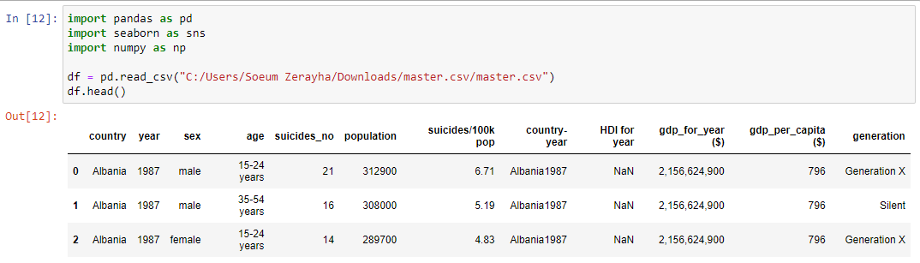
3. Code for outlier detection and removal
Step-1: Importing Necessary Dependencies and load dataset

Slide 8
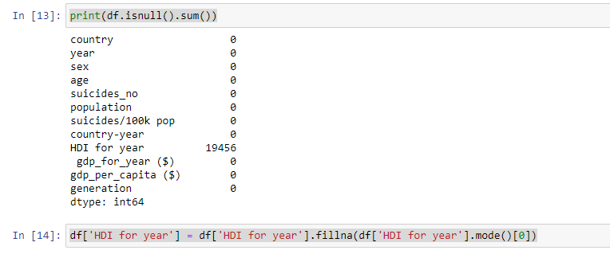
Step-2: Print and Fill missing Value

Slide 9
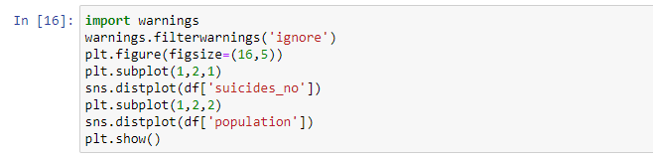
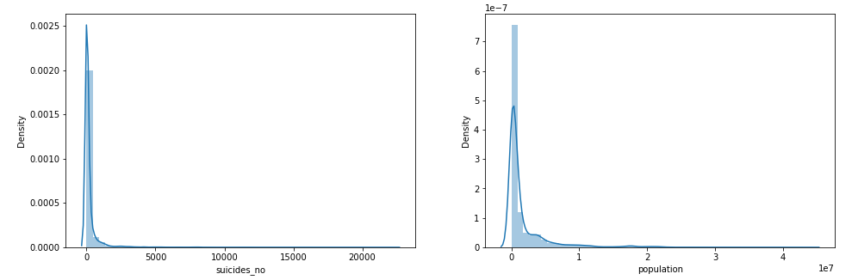
Step-3: Plot the Distribution plots for the features

Slide 10
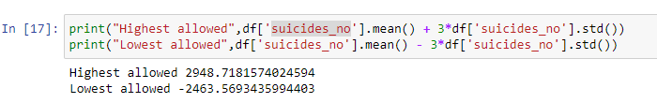
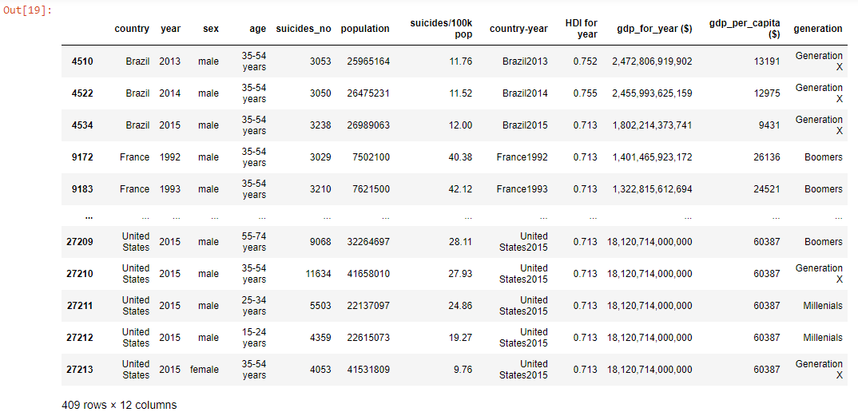
Step-4: Finding the Boundary Values
Step-5: Finding the Outliers

Slide 11
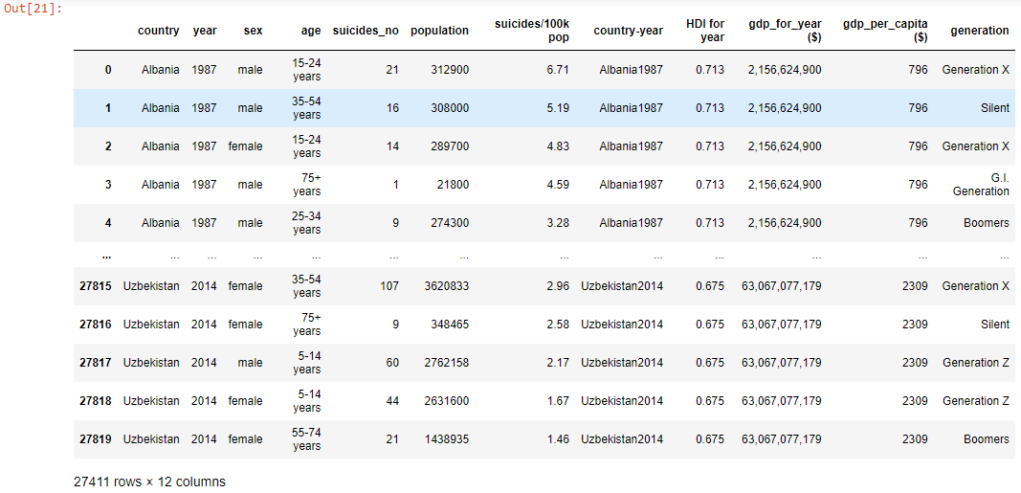
Step-6: Trimming of Outliers

Slide 12

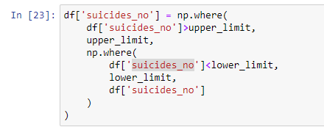
Step-7: Capping on Outliers
Step-8: Now, apply the Capping

Slide 13
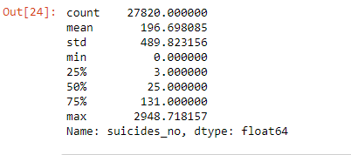
Step-9: Now see the statistics using “Describe” Function

Slide 14
4. Questions
Thank You!

